Slide 1

Binary

Slide 2
Binary
Before we start, some common terms that you will see:
Denary | Our base 10 counting system
Binary | A base 2 counting system
Bit (Binary digit) | The smallest possible storage area for data. Can only be 1 or 0
Byte | A group of 8 bits
Kilobyte | 1024 bytes

Slide 3
Binary
How a computer sees one byte:
128 | 64 | 32 | 16 | 8 | 4 | 2 | 1
Each of these storage areas represents 1 bit
One byte = 8 bits

Slide 4
Binary
The value of each bit doubles from right to left:
x2
x2
x2
128 | 64 | 32 | 16 | 8 | 4 | 2 | 1
This is how computers store all data.

Slide 5
Binary
In this example, the number 5 is represented in binary.
128 | 64 | 32 | 16 | 8 | 4 | 2 | 1
0 | 0 | 0 | 0 | 0 | 1 | 0 | 1
4
+
1
= 5
Where we see a binary 1, we add those numbers together to obtain the equivalent denary number.

Slide 6
Binary
Create your own binary grid like this:
128 | 64 | 32 | 16 | 8 | 4 | 2 | 1
And decode these binary numbers...

Slide 7
Binary
Convert the binary numbers into denary:
Binary | Denary
1OOOOOOO
1O1O1O1O
11111111
1111OOOO
OOOO1111
O1O1O1O1
O1OOOOOO
OOOOOOO1

Slide 8
Binary
Answers:
Binary | Denary
1OOOOOOO | 128
1O1O1O1O | 170
11111111 | 255
1111OOOO | 240
OOOO1111 | 15
O1O1O1O1 | 85
O1OOOOOO | 64
OOOOOOO1 | 1

Slide 9
Binary
Convert the denary numbers into binary:
Denary | Binary
127
0
192
6
89
199
200
42

Slide 10
Binary
Answers:
Denary | Binary
127 | O111111
0 | OOOOOOOO
192 | 11OOOOOO
6 | OOOOO11O
89 | O1O11OO1
199 | 11OOO111
200 | 11OO1OOO
42 | OO1O1O1O

Slide 11
Binary
Can you answer these questions in binary?
What is your age in binary?
What is your shoe size in binary?
What is your height in centimetres in binary?
What day of the month were you born in binary?

Slide 12
Binary
Can you decode these factoids from binary into decimal?
A man named Michael Lotito ate 00010010 bicycles in his life.
There are 00000101 babies born every second.
The word ‘hundred’ derives from ‘hundra’ in Old Norse, which originally meant 01111000.
Dr Seuss' book, Green Eggs and Ham, contains only 00110010 different words.

Slide 13
Binary
Answers:
A man named Michael Lotito ate 00010010 bicycles in his life. | 18
There are 00000101 babies born every second. | 5
The word ‘hundred’ derives from ‘hundra’ in Old Norse, which originally meant 01111000. | 120
Dr Seuss' book, Green Eggs and Ham, contains only 00110010 different words. | 50

Slide 14
Binary
ASCII
(American Standard Code for Information Interchange)
When we type on the keyboard, each character (letter, number and symbol) gets converted into an ASCII code. This is then converted to binary by the computer.
This means we can easily encode our name using binary!

Slide 15
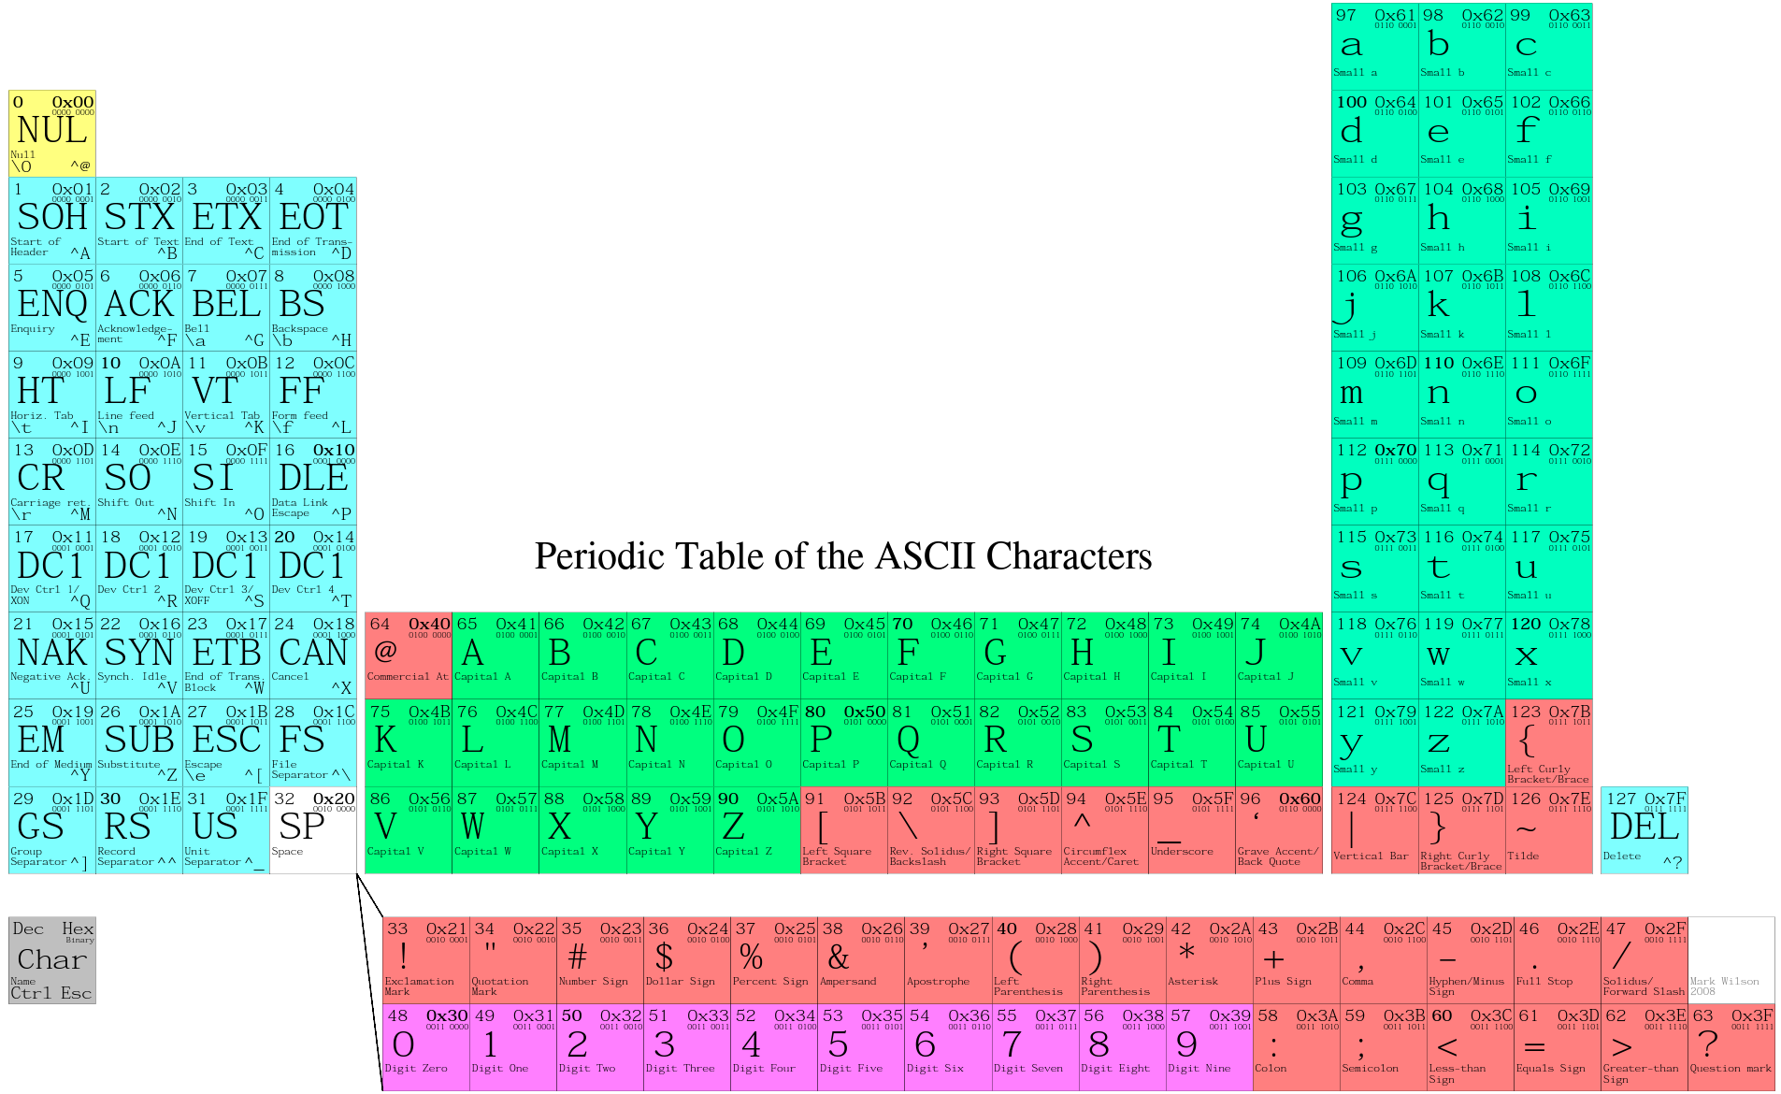
Binary
Using the ASCII table, can you convert your name into binary?
From: http://www.funnypolynomial.com/misc/creative/periodicASCII.pdf

Slide 16
Binary
Extension: create a secret binary code and send it to a partner to decode.

Slide 17
Binary

